Slide 1

Hosted by GRC Educators (Axons Technology and Solutions Pvt Ltd)
Address: 10685-B Hazelhurst Dr.
# 27262 Houston
TX 77043
USA
Phone : 713-401-9995
Email: support@grceducators.com
www.grceducators.com

Slide 2


Change Management Frameworks
FOR DIGITAL TRANSFORMATION
IŞIK DELİORMAN
February 09, 2024
01
Notes:
"Have you ever wondered why some organizations thrive during digital transformations while others struggle to adapt?

Slide 3
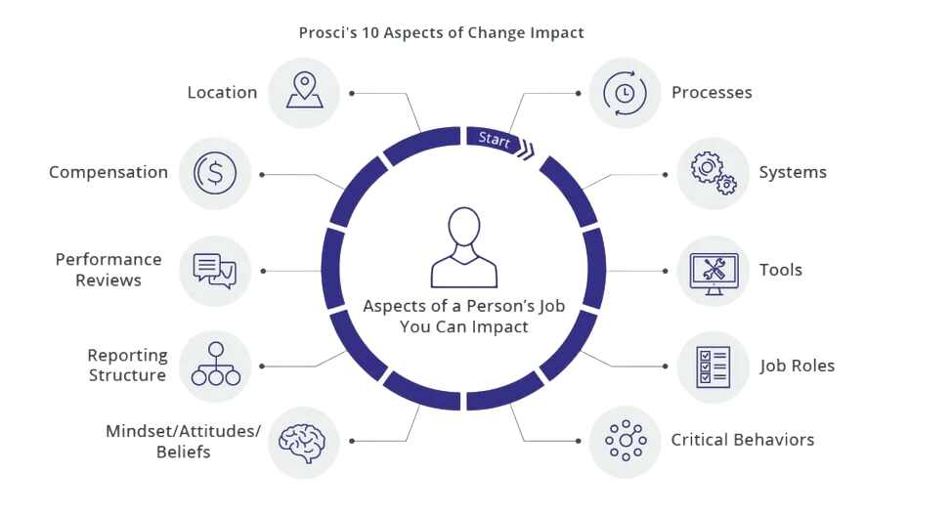

Prosci’s 10 Aspects of Change Impact
05
Notes:
The team at Prosci explored various change scenarios like implementing new systems or navigating mergers, considering their impact on individuals' professional lives across ten key aspects.
Processes: Change disrupts established processes, prompting a reevaluation and adjustment of workflows, protocols, and operational procedures.
Like in the case of implementing a new quality control process in manufacturing to enhance product reliability.
Change might introduce shifts in decision-making processes as well, affecting the criteria, stakeholders involved, and the overall approach to strategic choices.
Systems: Change often involves the implementation or modification of technology systems, like upgrading to a cloud-based collaboration platform.
Tools: New processes or roles may require the introduction of different tools or the adaptation of existing ones.
For example, adopting a project management tool to streamline workflows and enhance team coordination.
Job Roles: Change reshapes the functions and responsibilities of individuals, often requiring new skills or a shift in focus.
For example, with the introduction of a new software system, employees might take on additional responsibilities to manage and utilize the new technology effectively.
Critical Behaviors: The introduction of change influences how individuals interact, collaborate, and approach their tasks, fostering shifts in workplace behaviors.
A good example might be encouraging a culture of open communication and collaboration during a merger to foster a unified team.
Mindset/Attitudes/Beliefs:
Change seeks to influence the collective mindset and attitudes of individuals within the organization.
Shifting the organizational mindset from resistance to embracing innovation to adapt to market changes might be a viable example.
Reporting Structure: Changes may lead to restructuring of reporting relationships and hierarchies.
For instance, centralizing certain functions under a new department would improve coordination and efficiency.
Performance Reviews:Changes may alter the criteria and metrics used in performance evaluations.
New key performance indicators (KPIs) might be needed to align with strategic goals.
Compensation: Changes may influence how compensation structures are designed and distributed.
For example, performance-based bonuses might be introduced to tie to achieving specific goals.
Location: Changes can include relocations or adjustments to where work is conducted.
Shifting to a hybrid work model to allow employees to work both remotely and in the office might be the new paradigm.
The cumulative impact of changes influences the organizational culture, shaping its values, norms, and overall identity over time.

Slide 4
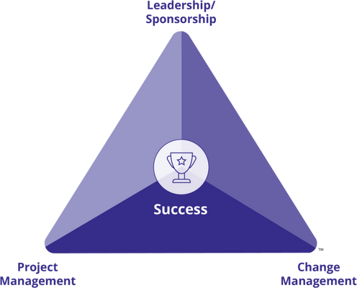
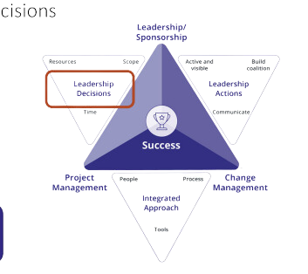
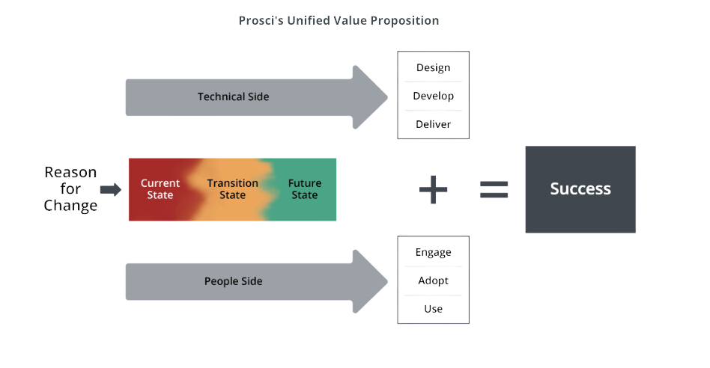
PCT (Prosci’s Change Triangle) Model
PCT Model is a framework that shows the four critical aspects of any
succcesful change effort and how they are interrelated: namely,
a shared definition of success with leadership/sponsorship,
project management and change management.
08
Notes:
Established in 2006 through client interactions, the Prosci Change Triangle (PCT) Model is a foundational component of the Prosci Methodology, complementing the ADKAR Model.
It serves as a unified framework, highlighting critical elements for successful initiatives and benefit realization.
The PCT model focuses on four key elements crucial for change and project health.
It emphasizes defining success, providing leadership, managing projects, and facilitating change management.
The model centers on a project's success. It highlights that, initially, we need to define success for effective change management strategy development.
Defining success for the change encompasses outlining the purpose, specifying project objectives, and identifying organizational benefits.
Leadership plays a vital role in project and change success, influencing decisions and actions.
Leaders and sponsors provide direction and guidance for the project. They take accountability for defining the change's purpose, aligning it with the organizational direction, and establishing its priority.
They determine and decide on crucial project dimensions like resources, scope, and time, influencing what needs to be designed, developed, and delivered.
They contribute uniquely to individual change journeys, by being active and visible, and by building coalitions.
Project management addresses the technical side of change. This includes designing, developing, and delivering solutions while adhering to the constraints of time, cost, and scope.
Change Management centers on the human side of change, with a focus on enabling people to effectively engage, adopt, and use the solution.
An integrated approach is essential, where people, processes, tools, and communication align with a common objective.
This approach recognizes the interconnectedness of these elements for comprehensive project and change management.
The PCT Model serves as a valuable tool for tracking and enhancing project health, ensuring successful change management outcomes.

Slide 5
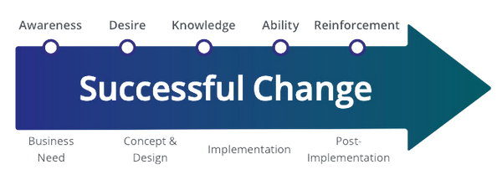
Prosci - ADKAR® Model
ADKAR® Model describes the five building blocks or ‘elements’ an individual needs to achieve
for a change to be successful. Impacted individual is at the center of the Prosci Methodology.
Individual success leads to organizational success.
Awareness of the business reasons for change
A
Desire to engage and participate in the change
D
Knowledge about how to change
K
Ability to realize or implement the change at the required performance level
A
Reinforcement to ensure the change sticks
R
09
Notes:
Organizational changes often encounter hurdles. Employees may lack understanding or motivation for change.
Leaders, in turn, may struggle to engage individuals effectively.
The Prosci ADKAR® Model, a cornerstone of the Prosci Methodology, addresses these challenges by providing leaders with strategies and tools and empowering individuals with the necessary information, motivation, and ability to navigate organizational changes successfully.
The ADKAR® Model was created by Prosci founder Jeff Hiatt.
It guides individuals through change, effectively complementing the Prosci 3-Phase Process during its second phase-Managing Change.
The Model, outlines the five crucial outcomes for individual change success: Awareness, Desire, Knowledge, Ability, and Reinforcement.
Awareness involves recognizing the need for change.
Desire signifies the willingness to participate and support the change.
Knowledge revolves around understanding how to change.
Ability entails implementing desired skills and behaviors.
Reinforcement is the crucial element focused on sustaining the change.
Prosci offers tools like Proxima, the ADKAR Blueprint, and the PCT Assessment. So that we can identify milestones, assess project health, and tailor support for individual roles, contributing to project success.

Slide 6
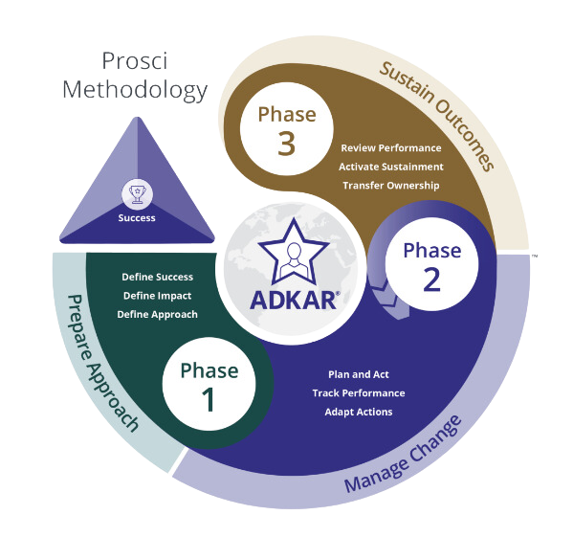
Prosci - 3 Phase Process
Phase 3 - Sustain Outcomes
Purpose: To realize the value of the change by ensuring the change is adopted and the organization is committed and prepared to sustain the change.
Change Management Closeout
Phase 1 - Prepare Approach
Purpose: To position the change for success by developing a customized and scaled change management strategy with the necessary sponsorship and commitment.
Change Management Strategy
Phase 2 - Manage Change
Purpose: To achieve adoption and usage of the change by creating, implementing and adopting plan(s) that will move individuals and the organization through ADKAR transitions.
Change Management Plan
10
Notes:
The Prosci 3-Phase Process, part of the Prosci Methodology, along with the PCT and ADKAR models, drives organizational change effectively.
While ADKAR focuses on individual change, the 3-Phase Process targets organizational change achievement.
Practitioners use both ADKAR and the 3-Phase Process for sustainable change.
The Prosci 3-Phase Process integrates the PCT model into three phases: Prepare Approach, Manage Change, and Sustain Outcomes.
The Prepare Approach phase lays the groundwork for change management strategy, defining success, impact, and approach.
The Manage Change phase operationalizes the strategy, planning actions, tracking progress, and adapting based on insights. It provides the Master Change Management Plan and execution.
The Sustain Outcomes phase ensures change adoption, activating sustainment actions and transferring ownership.
Phase 3 concludes with Change Management Closeout, documenting performance status and preparing for sustained outcomes.

Slide 7

DIGITAL TRANSFORMATION
21
Notes:
In today's ever-changing digital landscape, technological advancements and reliance on digital tools drive rapid evolution.
Embracing digital transformation gives businesses a competitive edge by adapting to market changes and fostering continuous improvement.
It also enables them to meet the demands of a connected, digitally savvy world.
This strategic approach positions companies to thrive in an environment that values adaptability and responsiveness.
As organizations seek to stay ahead, agility, scalability, and resilience become crucial.

Slide 8
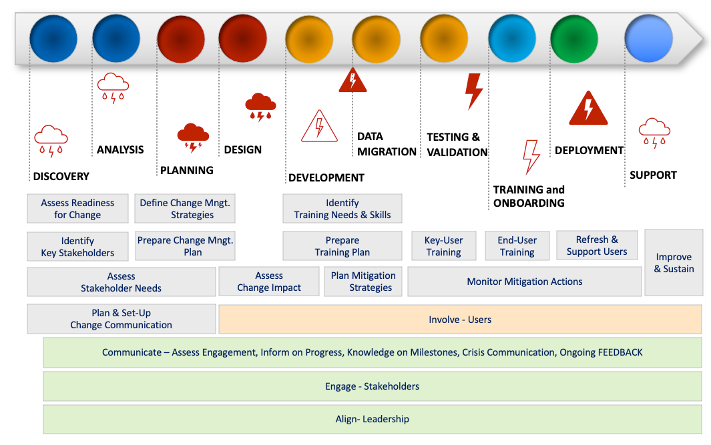
Change Management - ERP Implementation
29
Notes:
In a global SAP implementation hybrid (traditional and agile) project, we employed the ACMP Standard of Change Management. We strategically applied Peter Kotter's principles for engagement. In fact we integrated our change management approach to the global customized project management approach of the company.
We faced many challenges, such as key sponsor turnover, parallel PMO projects, budget constraints, technological infrastructure migration, global supply chain delays, and new business lines, and extensive localization needs. Thus agility and flexibilty was crucial. It could only be possible with the right people with relevant experience in the team.
All potential stakeholders were identified, their engagement levels were assessed at critical milestones and they were continually communicated through variety of channels and means.
We kicked off the project with a full-day 'Project Design' session, besides planning, with the sole objective of effectively engaging stakeholders and ensuring successful transformation.
We conducted impact assessments and developed mitigation plans, addressing strategic, operational, and cultural impacts.
We meticulously planned trainings and executed with discipline and close follow-ups, including knowledge assessments and satisfaction surveys.
Key users were trained as lecturers, backups were assigned, and refresher sessions were organized.
The implementation journey concluded with lessons learned sessions, ensuring a comprehensive and adaptive change management strategy throughout the complex ERP implementation phases.

Slide 9

Employee Empowerment
Empowerment
Training
Communication
Engagement
Develop and hire digital skills within the organization.
Provide training and upskilling opportunities for existing employees.
Foster collaboration both within and outside the organization through partnerships.
30
Notes:
In the realm of digital transformation, technology plays a pivotal role, but the success of its implementation rests on the shoulders of our employees.
Prosci stresses effective communication for fostering awareness, desire, and knowledge in change initiatives, with training integral to the ADKAR model for skill acquisition.
ACMP prioritizes communication planning, stakeholder engagement, and training, emphasizing stakeholder involvement and suitable training.
Kotter's 8-Step Model emphasizes urgency creation, vision communication, and employee engagement and empowerment.
We need to tailor training programs for new technologies to suit various learning styles and language preferences. Blending in-person training with online modules would facilitate sustained engagement.
We must communicate changes and incentives clearly throughout the digital transformation, ensuring each our people understand personal benefits.
We should encourage open communication, assigning dedicated points of contact for each team. We must regularly gather staff opinions and act on feedback actively. This would involve them in the transformation process.
Implementing these steps not only makes our people feel heard and valued but also secures their buy-in. Those steps would significantly boost the likelihood of a successful transformation.

Slide 10
Cultural Transition
Openness to Change
Agility
Customer-Centricity
Maintain open communication channels to address concerns and questions
Encourage teams to share their experiences, challenges, and success stories,
Foster a sense of collective learning and adaptation.
Encourage teams to be adaptable
Emphasize iterative development
Ability to respond to changing needs
Utilize agile methodologies that emphasize collaboration
Feedback quickly
Prioritize customer/user experience in all digital initiatives
Use customer/user feedback iteratively to enhance and improve digital solutions
Collect and use feedback to optimize the user experience, address pain points, and ensure that the digital solutions meet the evolving needs of the organization.
Experimentation
Promote experimentation in how digital solutions are deployed and integrated into existing workflows
Allow teams to test different deployment strategies
Monitor outcomes
Refine approaches based on results
Empower Teams
Empower teams to take ownership of the digital solutions they are implementing.
Provide training and support to enable teams to become proficient in using the solutions,
Foster a sense of responsibility for their successful adoption.
Continuous Learning
Create an environment where teams view implementation challenges as opportunities
Facilitate collaboration between different departments
Establish feedback loops
Allow for adjustments and refinements
Support continuous learning initiatives focused on the digital tools and technologies
Provide resources for ongoing skill development
31
Notes:
Culture plays a dual role in digital transformation, acting as both an enabler and a potential hindrance.
A positive organizational culture creates a supportive environment where employees feel empowered to adopt new technologies and processes.
Conversely, a resistant or stagnant culture impedes the acceptance and integration of digital changes.
Cultural transformation is pivotal for successful digital transformation. It involves a mindset that embraces change, encourages innovation, fosters collaboration, and values continuous learning.
It closely aligns with Prosci's emphasis on individual and organizational change, ACMP's focus on creating a positive environment, and Kotter's 8 Steps, especially in building urgency, fostering a coalition, and anchoring changes in corporate culture.
These models recognize that successful digital transformation entails a fundamental shift in organizational thinking, work culture, and collaboration.
For Digital Transformation success, leadership and project teams must prioritize a Customer-Centric approach, emphasizing user experience and iterative feedback.
Openness to Change can be fostered through effective communication and encouragement of collaboration.
Agility is supported by promoting adaptability, iterative development, and a quick response to changing needs through agile methodologies.
Experimentation allows testing different strategies and refining approaches based on results.
A culture viewing challenges as opportunities, promoting collaboration, and providing resources for ongoing skill development enables continuous learning.
Finally, empowerment of teams is achieved by allowing ownership, providing training and support, and instilling a sense of responsibility for successful adoption.

Slide 11

THANK YOU!
Change Management Frameworks
FOR DIGITAL TRANSFORMATION
IŞIK DELİORMAN
February 09, 2024
01
32

